Slide 1

WorldWide Concierge
The All-in-One Valet Management System
By: Kyle Johns, Chase Hunter

Slide 2
Introduction
WWC is a multi-purpose valet system
Modern and efficient way of storing vehicle data
Database adaptable to location
Subscription base your locations

Slide 3
Planning and Selection
We wanted to simplify a luxury service
Making valet a “digital” service
There are other solutions that are digital
All encompassing, digital, simple

Slide 4
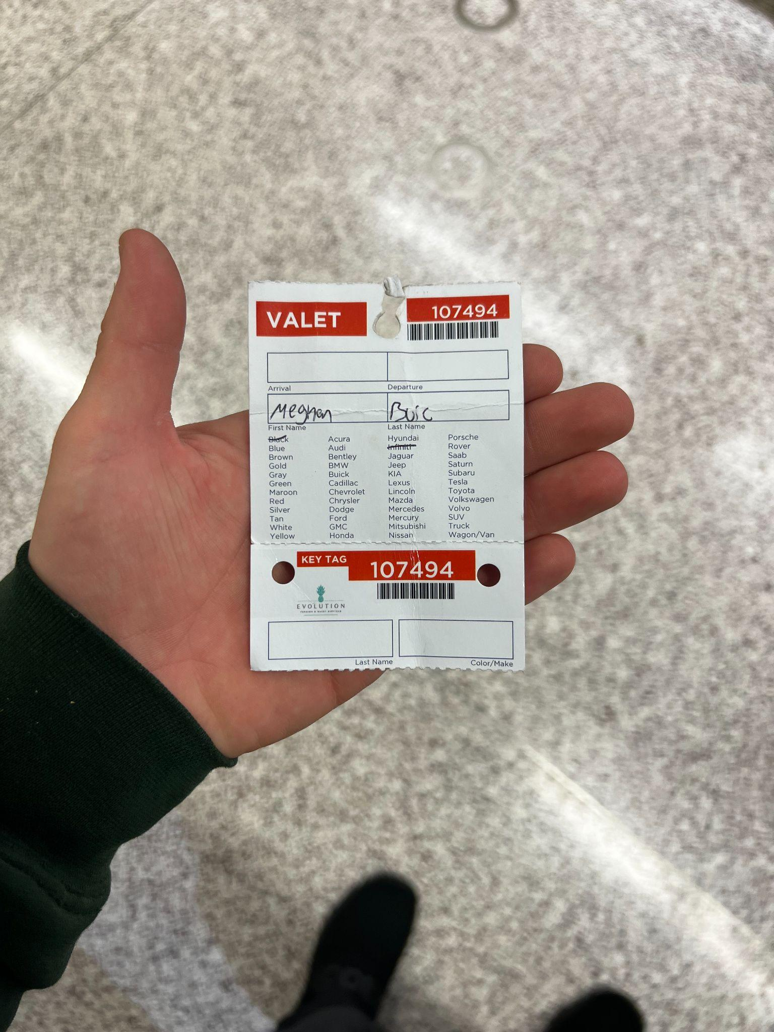
Systems Analysis
Physical and easily lost
How could we make this simpler
Modern or old fashion?

Slide 5
System Designs
Web forms to collect users input
Website to enhance and deliver information of system
Database to support
Various types of locations (lot or garage)
Quick easy to read report

Slide 6
Implementation and Operation
The system can be scaled with garage or lot
WWC GUI is the simple and quick form
Report quick and easy to communicate

Slide 7
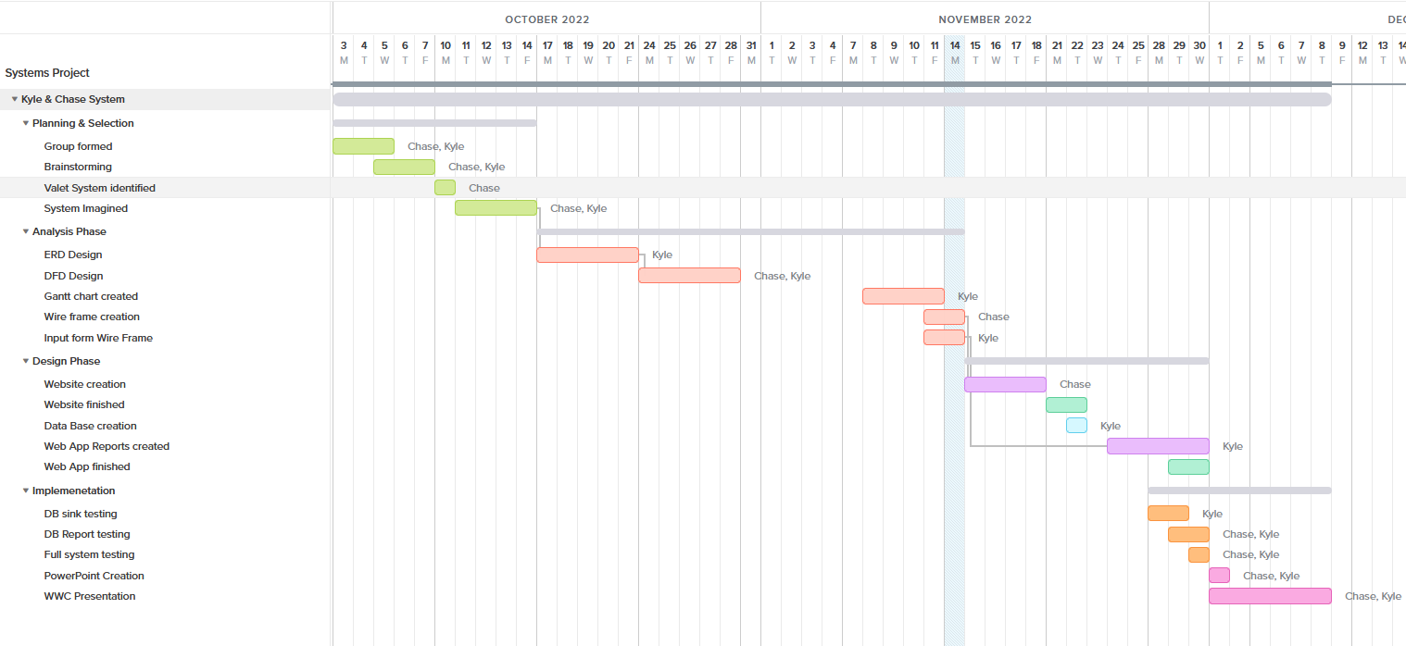
Gantt Chart
Timeline of events from the first day of planning for the project, all the way to presentation day.

Slide 8
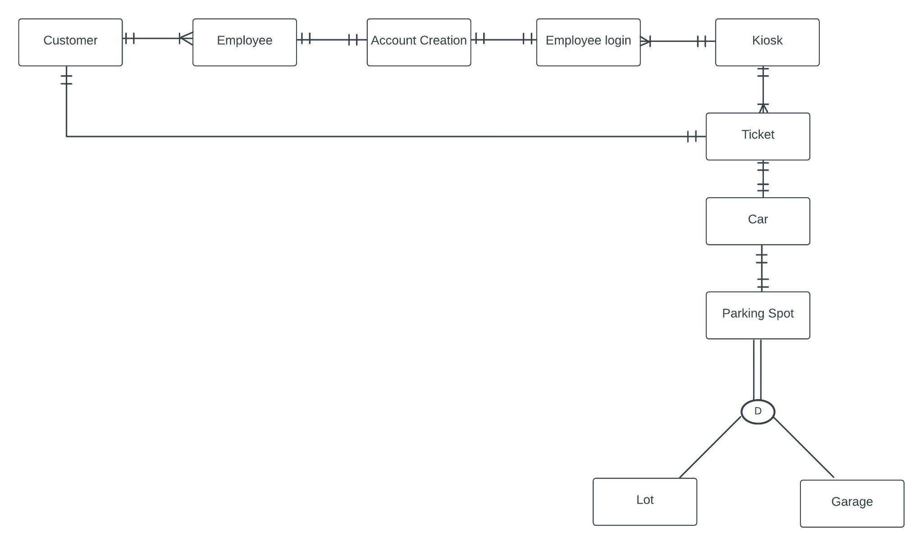
Entity Relationship Diagram

Slide 9
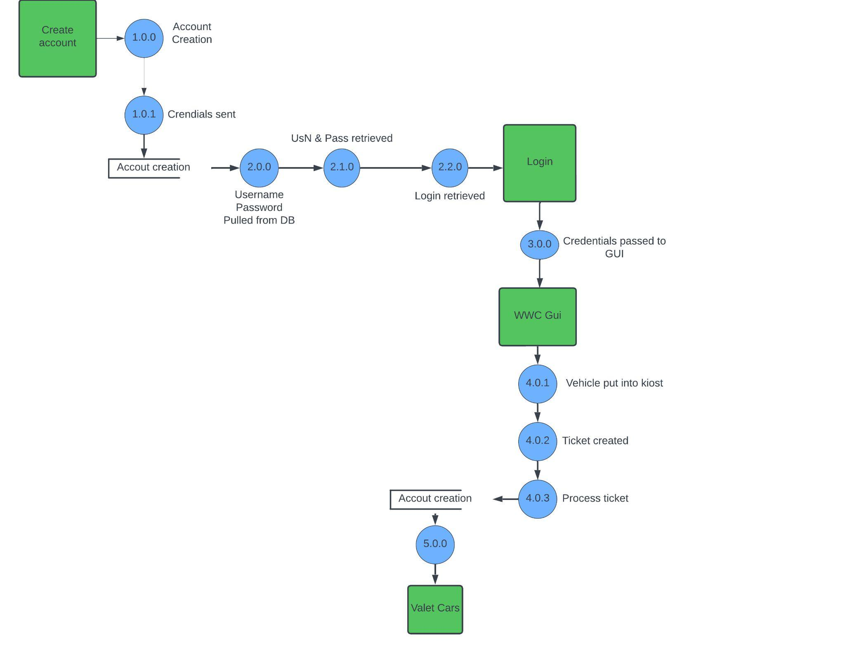
Level two DFD

Slide 10
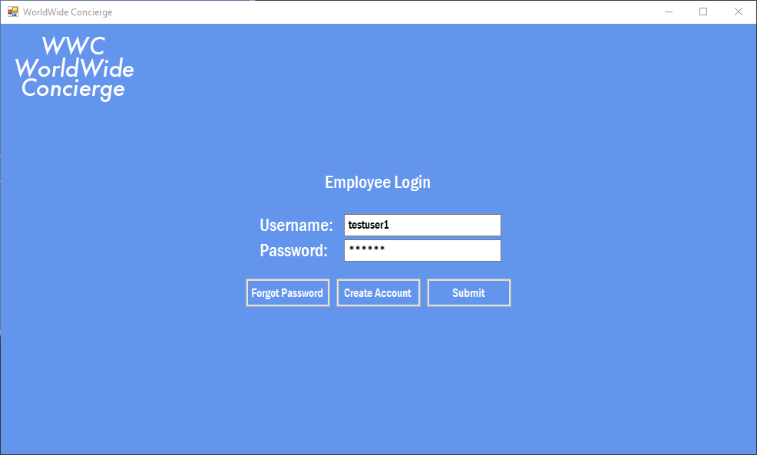
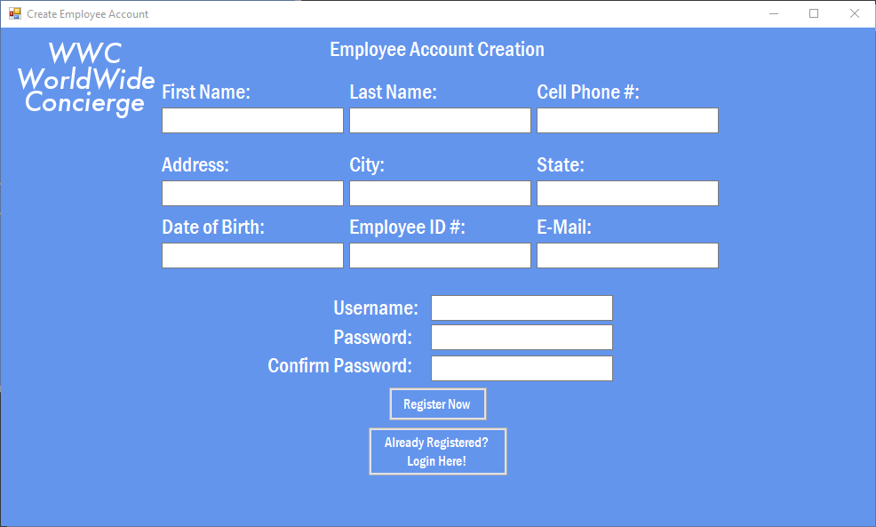
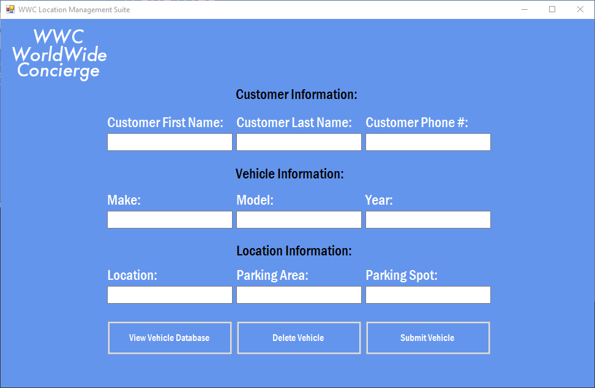

Prototype Forms
First Logo Design

Slide 11
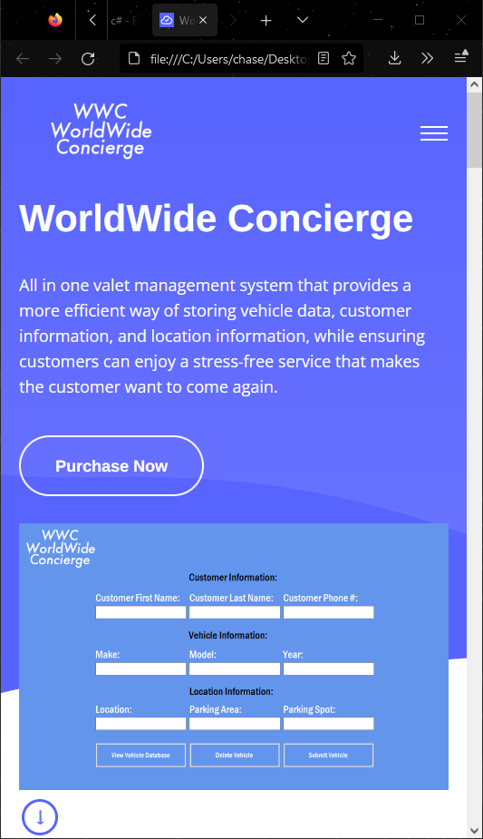
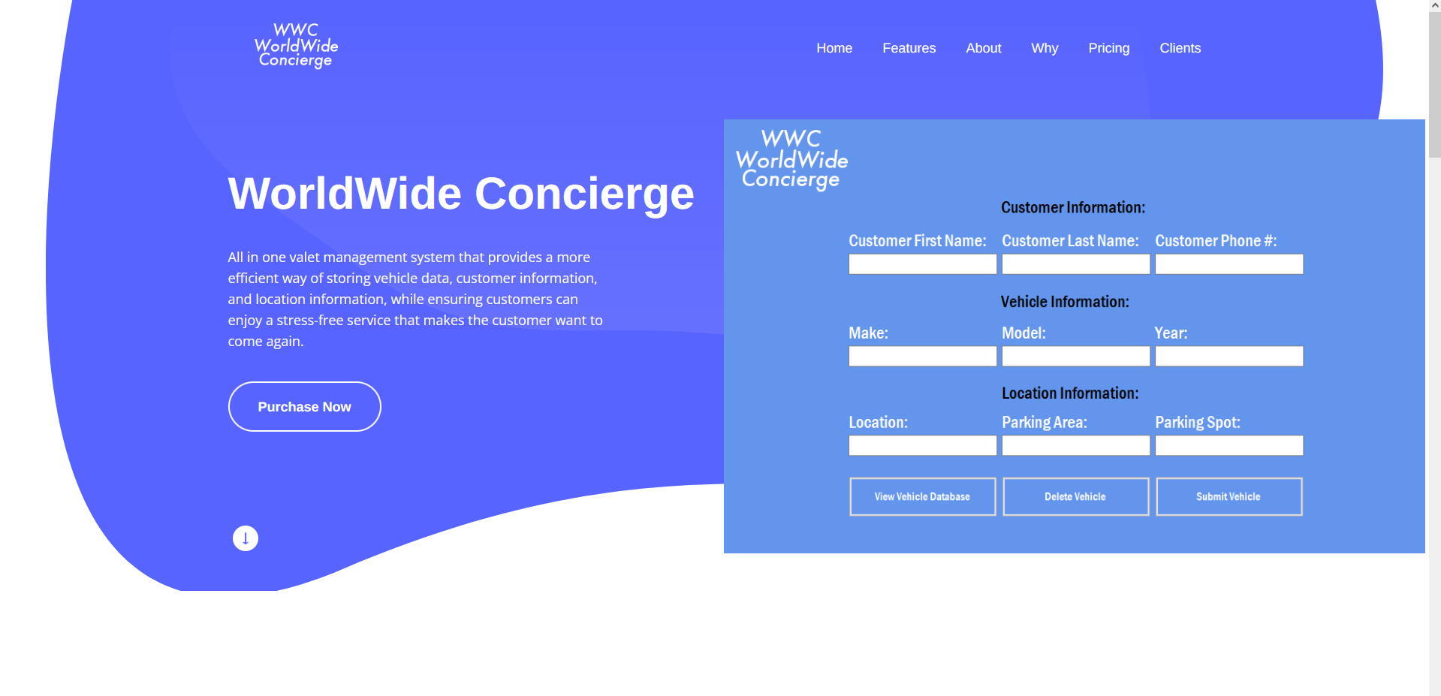
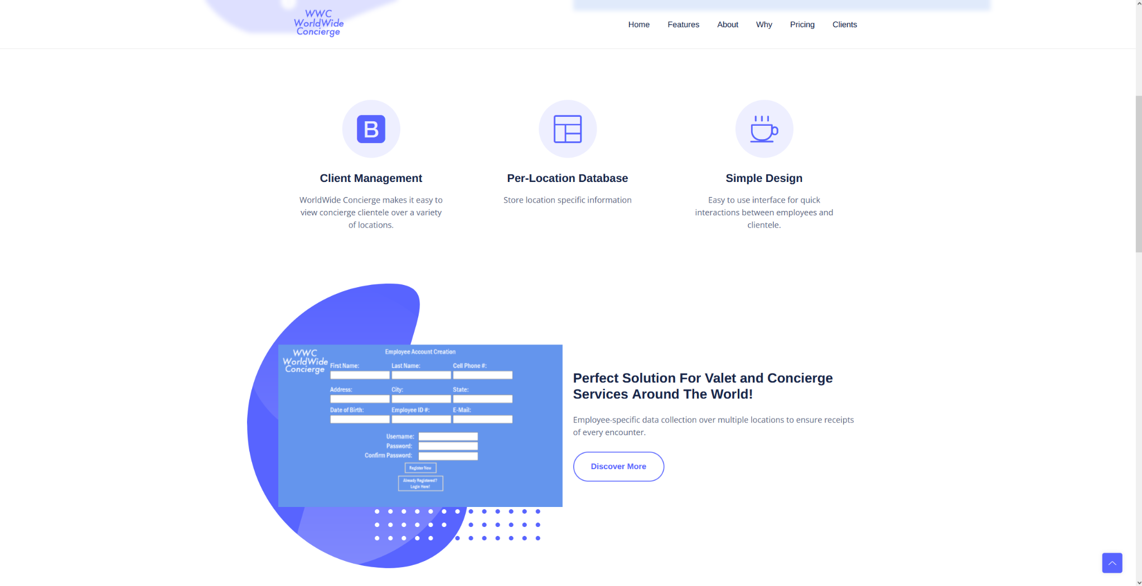
Prototype Website

Slide 12
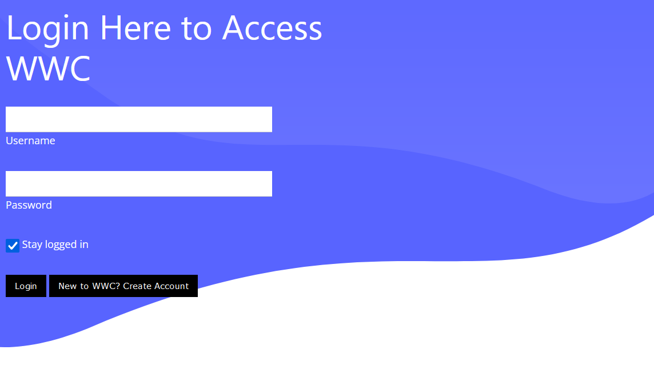

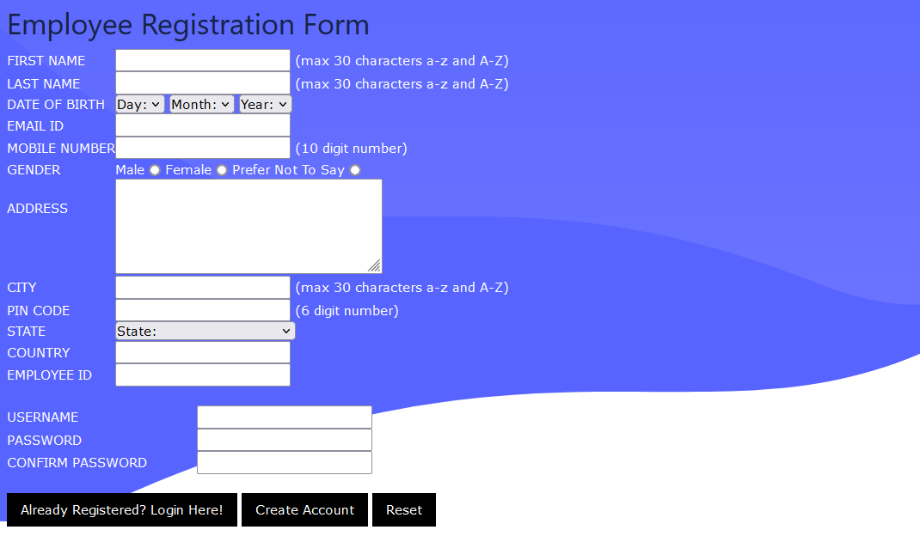
Final Form Design

Slide 13
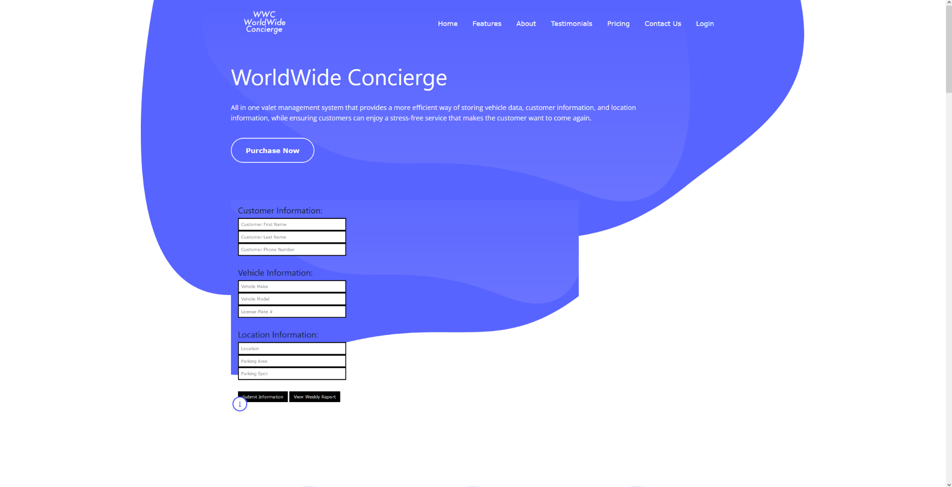
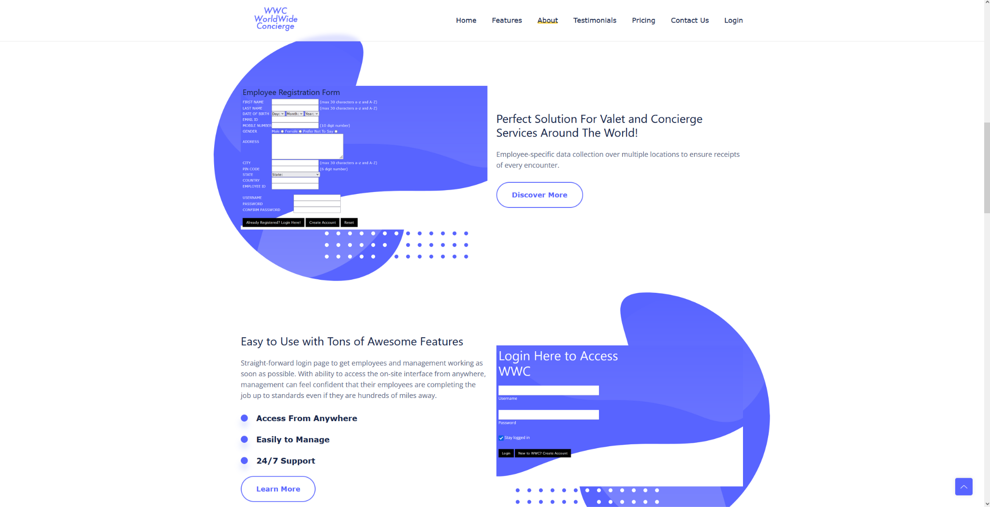


Final Website Design
Final Logos - Blue and White: Simple and more pleasing design to fit with the theme of the website. Logo is either white or blue depending where the user is at on the webpage.

Slide 14
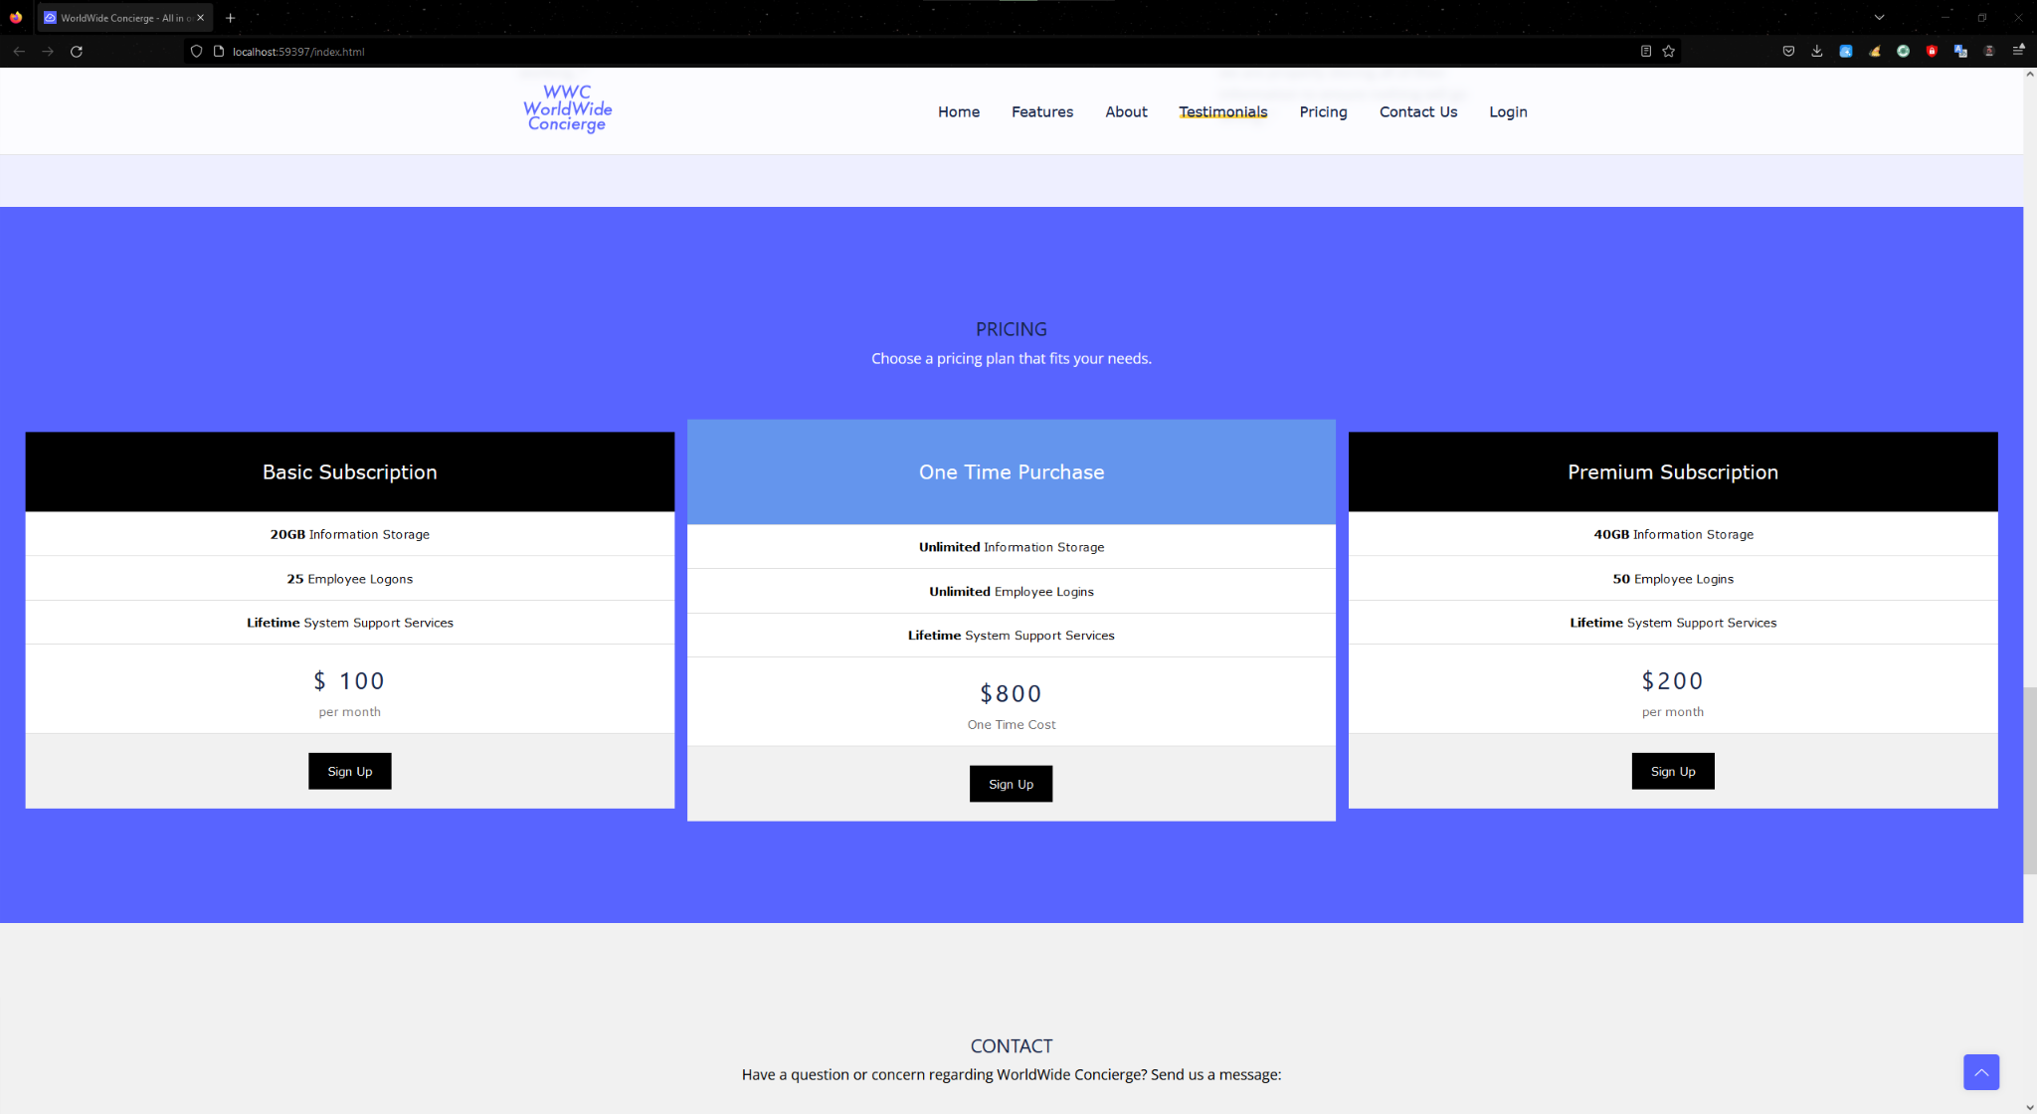
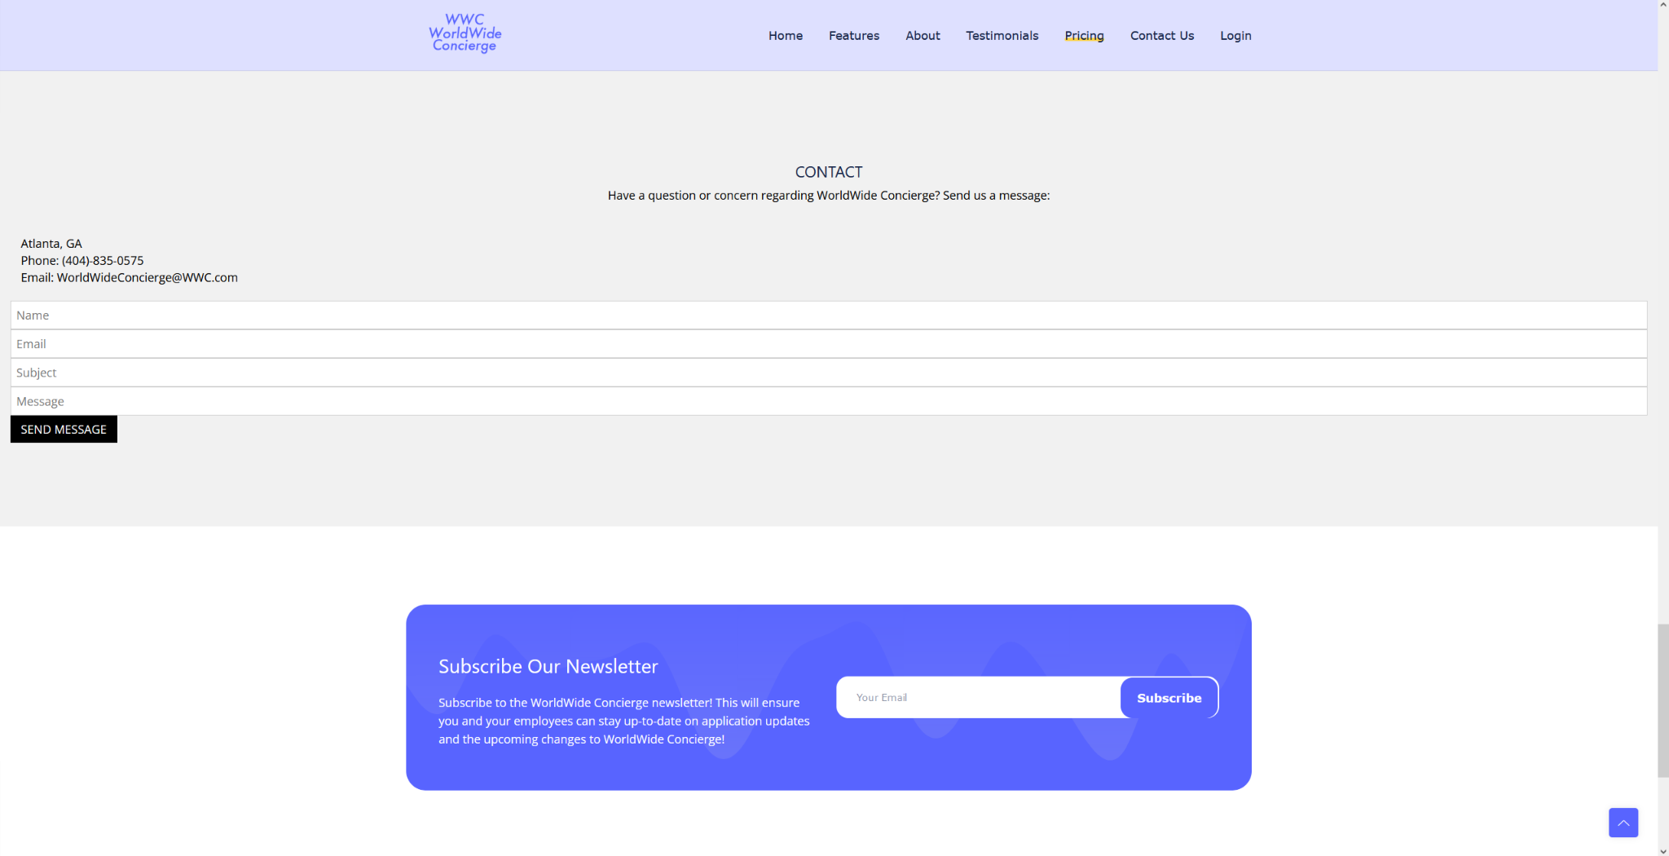

Final Website Design - Continue

Slide 15
Live Demo
Live demo of the WorldWide Concierge website.

Slide 16
Thank You
We hope you enjoyed!

